Slide 1

MEDIA
&
THE PUBLIC
Week 10
Political persuasion on social media
Ryan Wang
ryanyang@psu.edu

Slide 2
Diehl, Weeks, & Gil de Zuniga (2016)
Political persuasion on social media: Tracing direct and indirect effects of news use and social interaction

Slide 3
Background
How might individuals be persuaded to reconsider their political views?
  News media
  Social context of peer group
  Or both
Deliberative democracy: political persuasion through conversation
Social media: where citizen are simultaneously exposed to news, and the views of people in their social network.
  A shared context (in the form of news and other political information)
  The opportunity to speak and debate about politics (although not the primary motivation)
  Other deliberative attributes
    Diverse networks
    Exposure to discussion disagreement
Notes:
Deliberative democracy or discursive democracy is a form of democracy in which deliberation is central to decision-making. It adopts elements of both consensus decision-making and majority rule
this ideal context would include a shared text, a set of issues to discuss, the opportunity to speak and debate, as well as exposure to diverse opinions

Slide 4
Background
Dependent variable (2nd wave):
  Social media political persuasion (Cronbach’s α=.87; M = 2.22, SD = 1.69)
    “I have changed an opinion based upon what someone influential to me posted on social media.”
    How often they “take part in changing your mind about political issues because of information or interactions on social media”
    How often they “take part in reconsidering your political views because of information or interactions on social media.”
Independent variables (1st wave):
  Social media for news (Cronbach’s α = .89; M = 2.7; SD = 1.96)
    How often they “encounter or come across news when using social networking sites”
    How often they “encounter or come across news when using micro-blogging sites”
    How often they use social media to “stay informed about current events and public affairs”
    how often they use it to “stay informed about your local community”
    The frequency of getting news from Facebook
    The frequency of getting news from Twitter
    How often they get news from the general news media through social media
Notes:
DV: how often respondents reconsidered or changed their political views based on information they encountered on social media

Slide 5
Background
Independent variables (1st wave):
  Social media for social interaction (Cronbach’s α = .78; M = 3.56, SD = 2.3)
    How often they used social media “to stay in touch with friends and family”
    How often “meet new people who share interests”
    How often “to contact people you wouldn’t meet otherwise”
  Network heterogeneity (Spearman-Brown reliability coefficient = .93, inter-item r = .87; M = 3.6, SD = 2.64)
    How often respondents “talk about politics or public affairs online and offline with people from a different race or ethnicity”
    How often respondents “talk about politics or public affairs online and offline with people from a different social class”
  Discussion disagreement (Spearman-Brown reliability coefficient = .92, inter-item r = .86; M = 3.6, SD = 2.5)
    How often respondents “talk about politics or public affairs online and offline with people whose political views are different from yours”
    How often respondents “talk about politics or public affairs online and offline with people who disagree with you”
Notes:
This item sought to capture respondents’ exposure to political views that differ from their own.

Slide 6
Hypotheses
H1: Social media use for news will be positively associated with network heterogeneity.
  Diverse networks tend to encounter a variety of viewpoints, which in turn leads to an increased demand for news to digest those viewpoints
H2: Network heterogeneity will be positively associated with political persuasion on social media.
  Individual’s opinions and attitudes are contingent upon characteristics imbedded in their social connections
H3: Discussion disagreement will be positively associated with political persuasion on social media.
  Individuals who experience disagreement are more likely to moderate their opinions
H4: Social media use for news will be positively associated with political persuasion on social media both directly, and indirectly, through network heterogeneity and discussion disagreement.
  News use also increases the likelihood that one will argue about politics and facilitates exposure to dissimilar views
  Offline literature: Diverse network of social connections should naturally lead to a higher volume of competing or conflicting views, and ultimately more ambivalent attitudes

Slide 7
Hypotheses
H5: Use of social media for the purpose of social interaction will be positively associated with political persuasion on social media both directly, and indirectly, through network heterogeneity and discussion disagreement.
  Direct effect: Directly through an elevated importance of social influences on attitude formation
  Indirect effect: Indirectly through the structural affordances of social media in building and maintaining diverse networks
    Network heterogeneity as a natural outcome of the social and technological incentives for social interaction on social media
    Diverse network leads to exposure to dissenting political discourse
Notes:
when someone is considering the views of their friends or family, persuasion is associated with a concern for a favorable evaluation from their peers, and the need to maintain relationships in that network. individuals look to their network for a persuasion cue, either in the form of group consensus or the opinion of someone influential in their network
when an individual reaches out to their network for social interaction, they may be cautious of damaging their public reputations, and thus moderate their discussion behavior. If online networks are more diverse, and the messages circulated are sensitive to the maintenance of that network, it follows that social interaction will lead to networks characterized by a tolerance for diverse viewpoints.
politically themed discussion groups displayed the tendency for homogeneous political conversation, and discussion disagreement occurred less often. In offline studies, exposure to discussion disagreement, particularly in a social context where one is aware of the views of others in their network, leads to a tolerance for the views of others, and more ambivalent political opinions

Slide 8
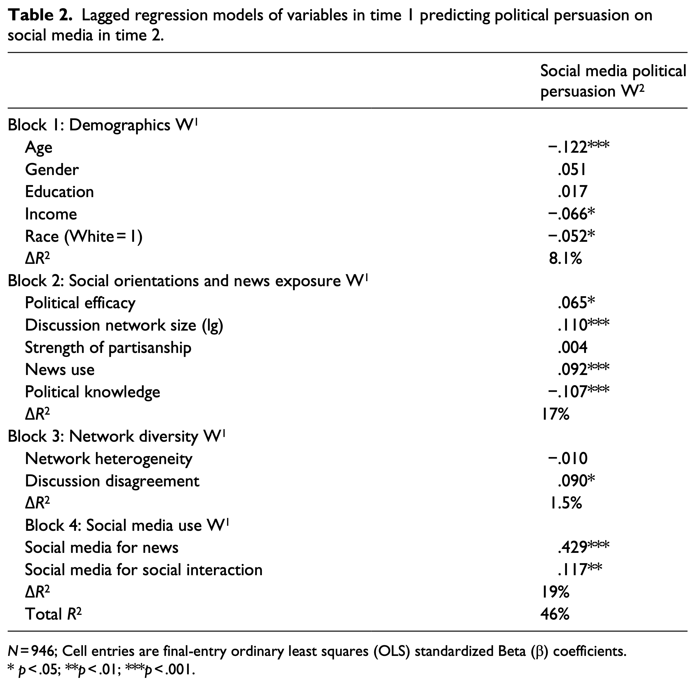
Results
H2
H3
Notes:
Lagged regression model

Slide 9
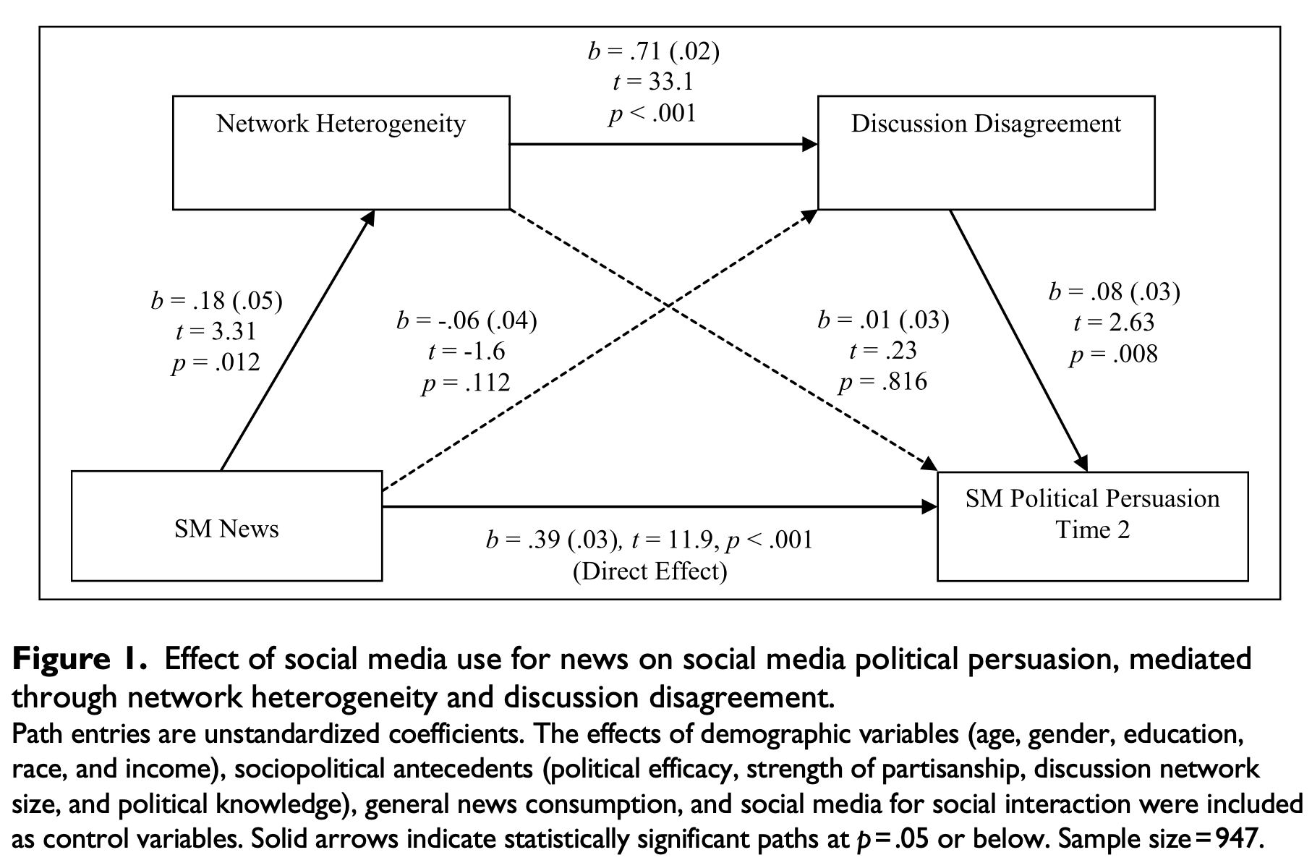
Results
H4(b)
H1
H2
H3
H4(a)

Slide 10
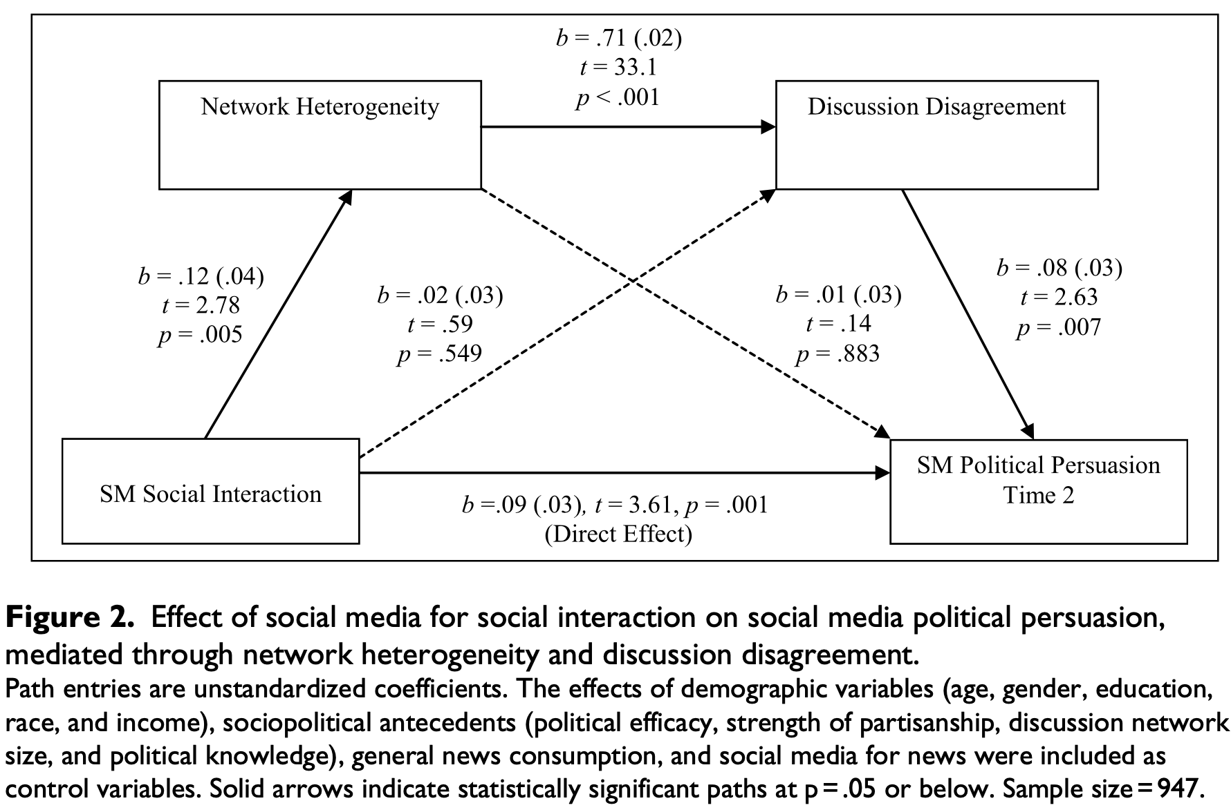
Results
H5(b)
H5(a)

Slide 11
Key takeaways
Social media for news has the strongest impact on political persuasion on social media
  Indirect effect: social media for news – diverse network – exposure to heterogenous discussion - changing political attitudes or opinions on social media
Social media for social interaction directly influence political persuasion
  Social needs – network heterogeneity (technological affordance) – political discussion of diverse viewpoints - more flexibility in the formation of political attitudes
No significant direct relationship between on network heterogeneity and persuasion on social media
  The size of one’s network also matters
  Network heterogeneity alone does not necessarily mean that persuasion on social media will occur
Notes:
The results suggest that political attitude formation on social media depends on exposure to discussion disagreement. If one discusses issues with those of an opposing view, they are more likely to be aware of their own position, and more likely to understand the counter viewpoint

